Slide 1
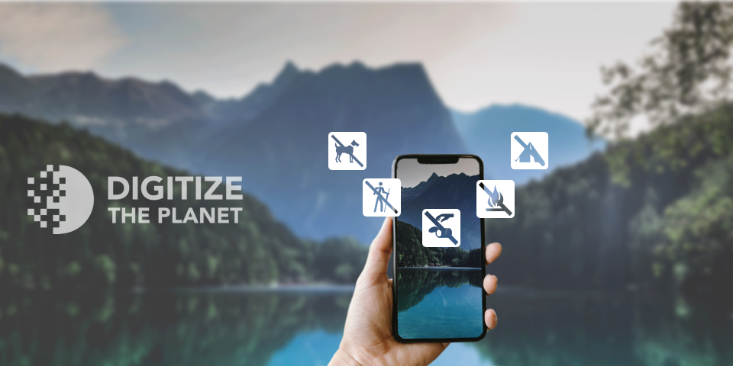

Slide 2
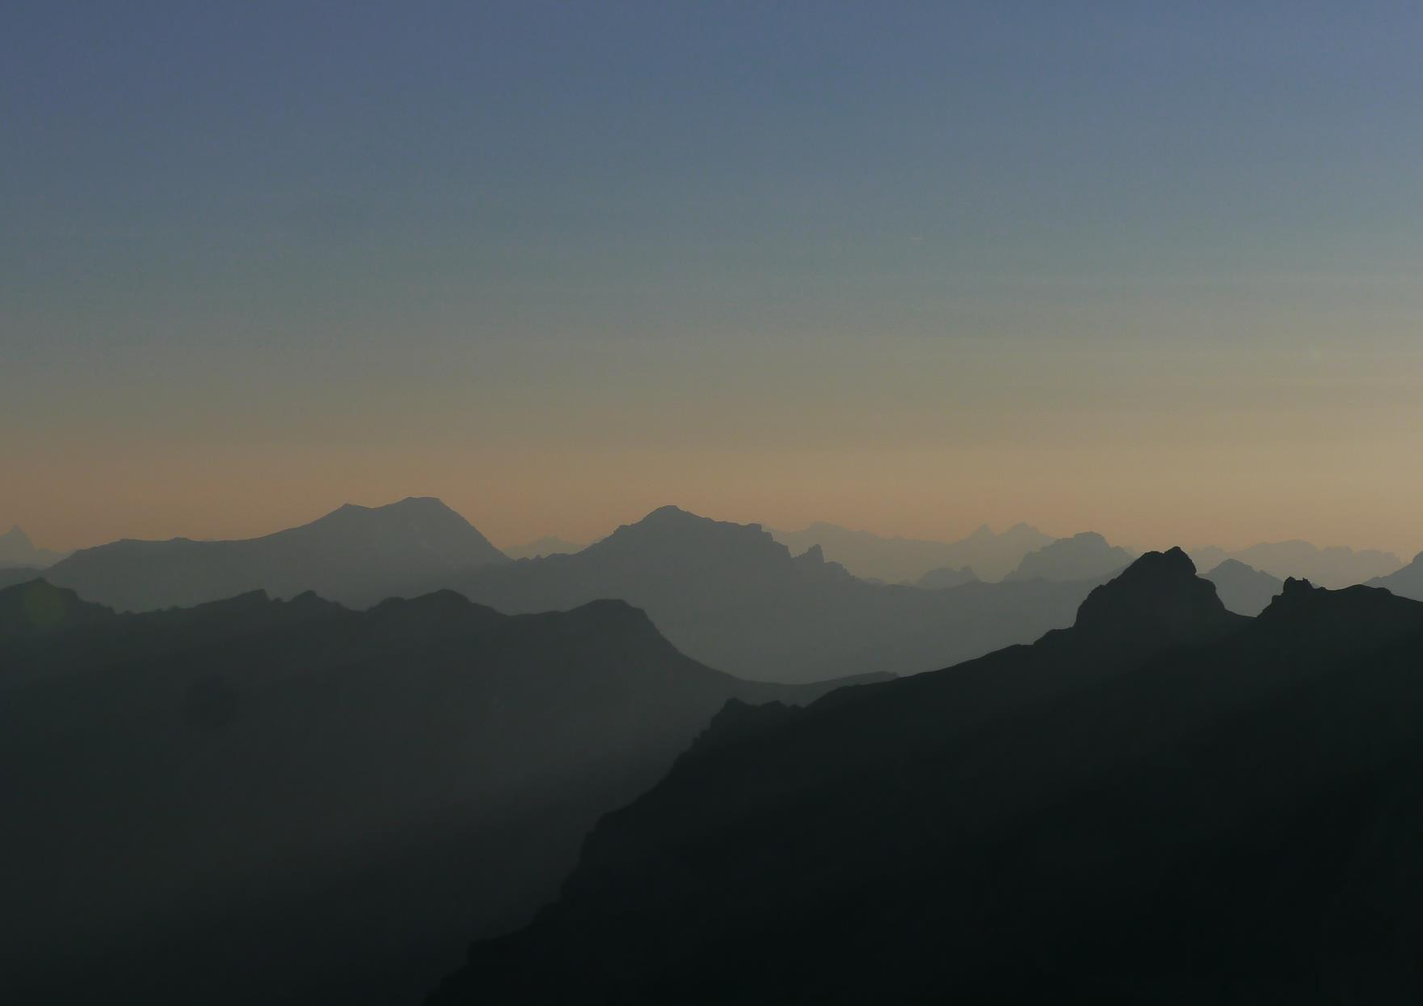
Digitize the Planet
We want to provide visitors an experience with a good-feeling by supporting everyone to enjoy nature according to the rules without burdening it.
We achieve this goal by digitizing all relevant rules, including laws and local agreements for use in nature.

Slide 3
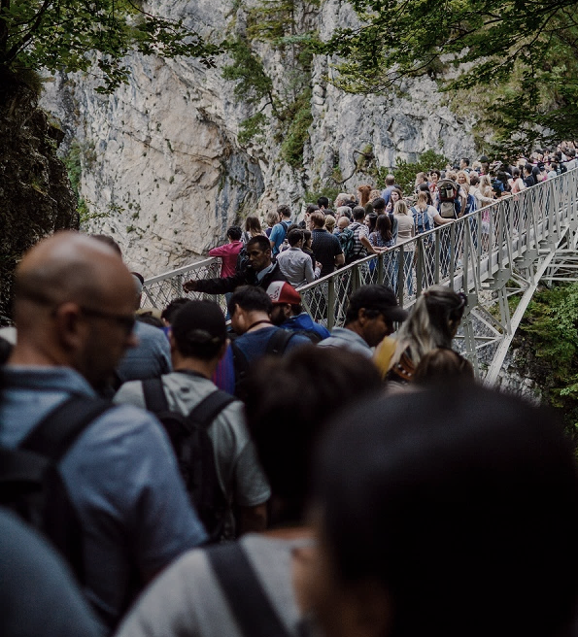
More and more people enjoy nature, but often they don't know the rules.
The consequence
Pressure increases even where strict protection is agreed.
Sensitive areas get exposed to excessive pressure.
Conflicts between users increase.
Landowners become more restrictive.
Guests are dissatisfied.

Slide 4

The tour begins long before the departure...
Only with digital information guests can be reached before they arrive at their destination.

Slide 5

The user wants an all-in-one digital solution without having to search for all the information separately.
Digital solutions are emerging
Lack of digitalization
Traffic
Parking
Public transport
Last mile
Time of day
Opening hours
Requirements
Prices
Equipment
Trails
Routes
POIs
Experiences
Protected areas
Rules
Behavior
Agreements
Nature conservation

Slide 6
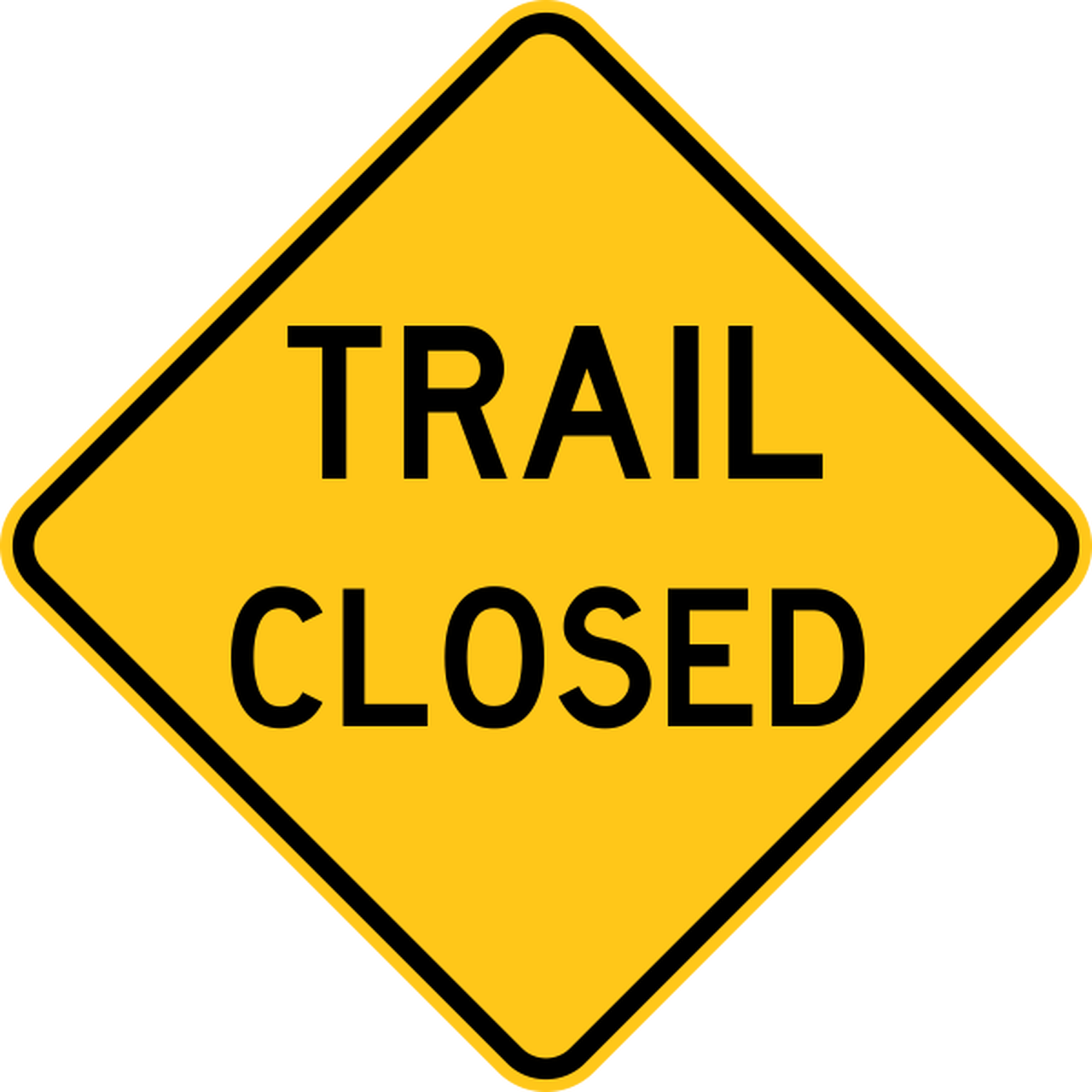





Bundle, simplify and provide information.
Format Properties:
Structured
Open data
To ensure that the information can easily reach all visitors at the right time, the information must be able to be integrated into each system
International
Standardized
Machine readable

Slide 7




So far, no one has taken on digitization.
The task was started in March 2020.
Foundation of the association with important stakeholders from sport, platforms, nature conservation and tourism

Slide 8




















Members
Everyone from sport, tourism, administration and nature conservation is part of the problem and can be part of the solution.
David Wewetzer
Prof. Dr. Alexander Dingeldey

Slide 9





Five core tasks of our association
1. Examine the rules and regulations
  Framework, explicit rules for recreational use
2. Create a digital format
  Concept for the structured mapping of rules
3. Create data
  Digitize rules and regulations
4. Process data
  Publish data, freely accessible to all as Open Data
5. Explain
  Press reports, student research projects, events

Slide 10
1. Examine the rules and regulations
Main aspects:
Which laws and which areas are marked by rules for recreational use?
What terms and categories are used for areas, paths and activities?
Where to find the rules?
Laws
Political region
Regulations
Protected landscapes
Local regularization
Regional

Slide 11




2. Create a digital format
Create a standard that enables easy maintenance and integration into common systems.
Existing data formats:
  Areas (polygons) as data with location, name, category
  Rules in laws and regulations as text documents and digital scans (PDF)
  Road networks with (partial) attributions on OSM and official data
Missing data formats:
Make rules machine-readable and avialable for existing systems:
Subject | Validity | Basis | Penalty
Access | from 01.05. till 31.10. | Law | 500 €
Motor vehicles | on designated roads | Law | 1.000 €
Mountainbikes | on designated roads | Law | 500 €
Offroad | No | Law | 500 €
Camping | No | Law | 50 €
Open fire | In designated places | Gesetz | 50 €
Mushroom picking | Max 1 kg per person/day | Local rule | 50 €
Fishing | No | Law | 5.000 €
Horse riding | on designated roads | Law | 500 €
Dogs | Only on the lead | Local rule | 100 €
Helmet | recommended | Safety
Drone | Yes
Snowslide equipment | recommended | Safety

Slide 12
2. Create a digital format
Spatial representation of the rules for recreational use.
Many of the important regulations concern activities that take place on the area, such as camping, fires or drone flights.
Path categories that are subject to bans and prohibitions can be inherited by the entire road network of the area..
Rules or prohibitions for individual roads can be entered in the road network.
Area-related information
  (apply to the total area)
Rules on path categories
(within an area)
Single paths

Slide 13



3. Create Data
A freely usable data set for the rules on the recreational use of nature.
Administration and authorities are enabled to enter information into the database via an interface.
The association is creating a concept for the digitisation of small protected areas and sensitive spaces without independent administration.
Cooperation with initiatives that make and publish local agreements.
Nature conservation authority
Administration
Alliances

Slide 14

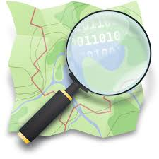
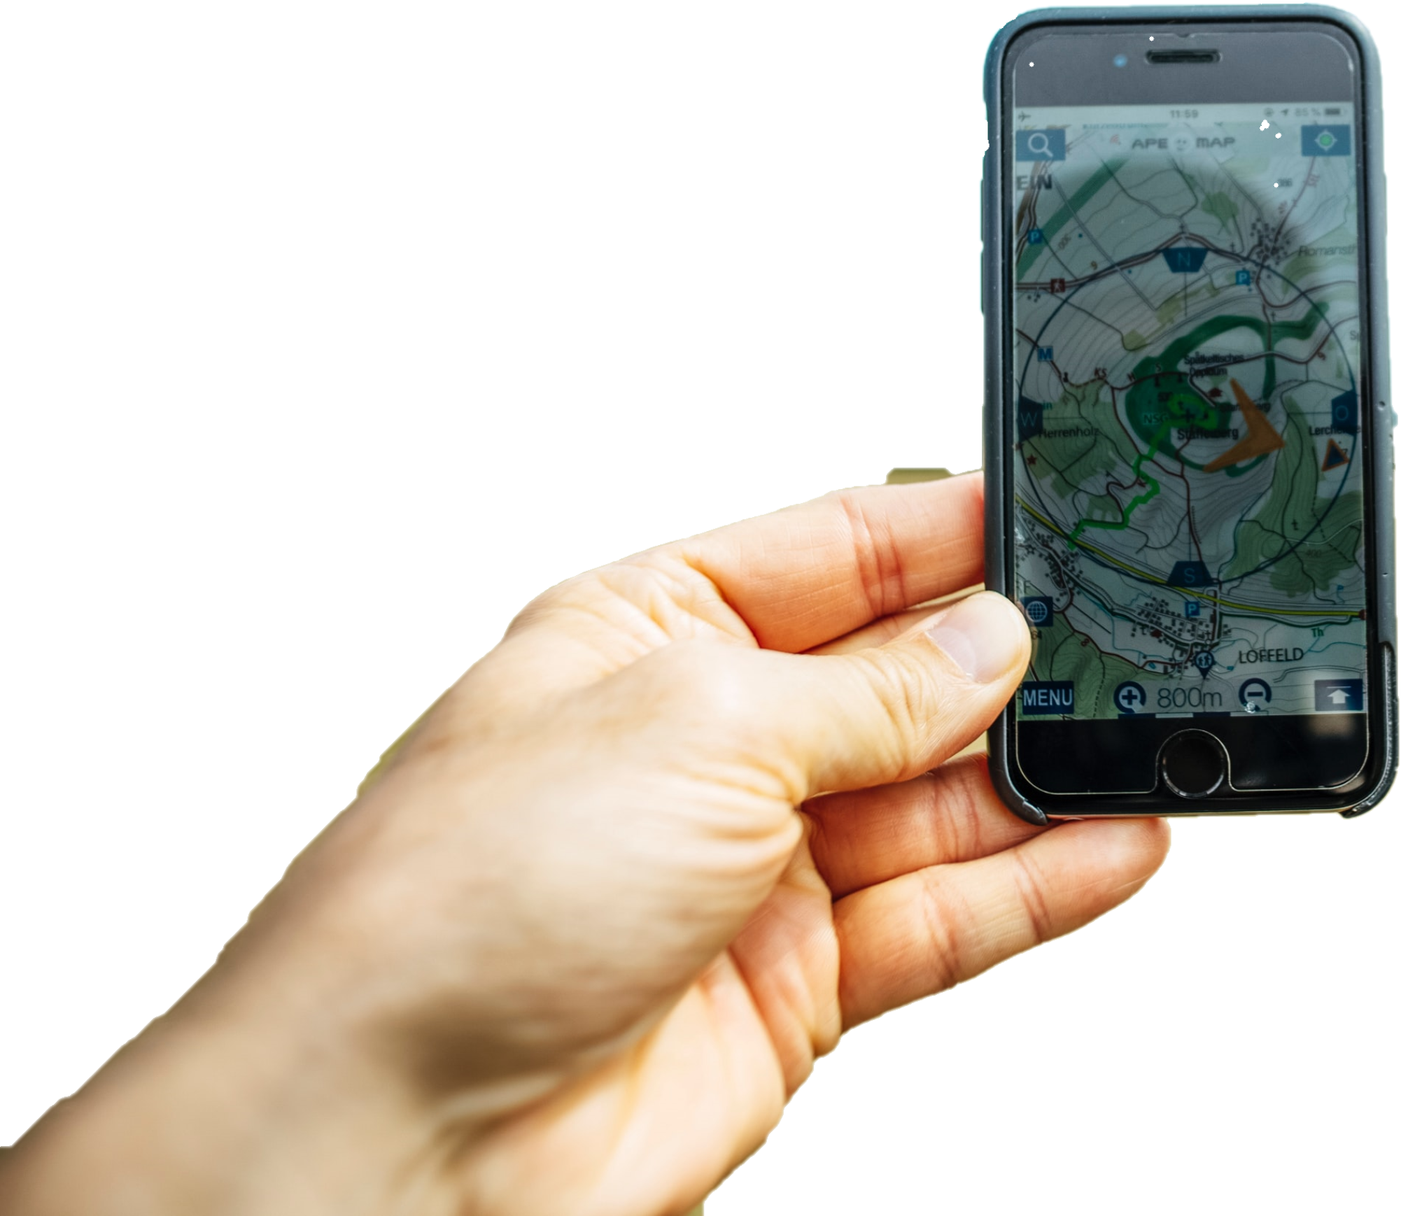







4. Process data
Make data available as Open Data and ensure that it is published on the “right” channels.
We actively distribute the data to platforms, map services and databases.
We are building an international network for this purpose.

Slide 15
5. Explain
Information about our standard, which problem we solve with it, the available data and the possibilities.
Website:
Through our work, we build up important expertise that we make accessible via our website.
We network ourselves and others with public initiatives.
A series of events with an exchange of news from the association and topics such as visitor guidance.
We actively participate as speakers at important events such as the FOSSGIS Conference 2021.
We are project leaders or partners.
Network:
DIGITIZE Dialogue:
Events:
Research projects
And funded projects:

Slide 16
We are all part of the problem, so join in and become part of the solution…

Slide 17
Participate
Membership:
As a member who shapes and supports the association with us.
We are also happy to receive donations that will help us to significantly advance our project.
New data is important, as well as support from experts in environmental protection, tourism, sports or technology and digital.
We are suitable partner and supporter within the framework of research and funding projects.
The inclusion of our project in the communication of our members, partners or simply interested supporters, allows us to grow and expand the work.
Donation:
Data:
Partner:
Network:

Slide 18
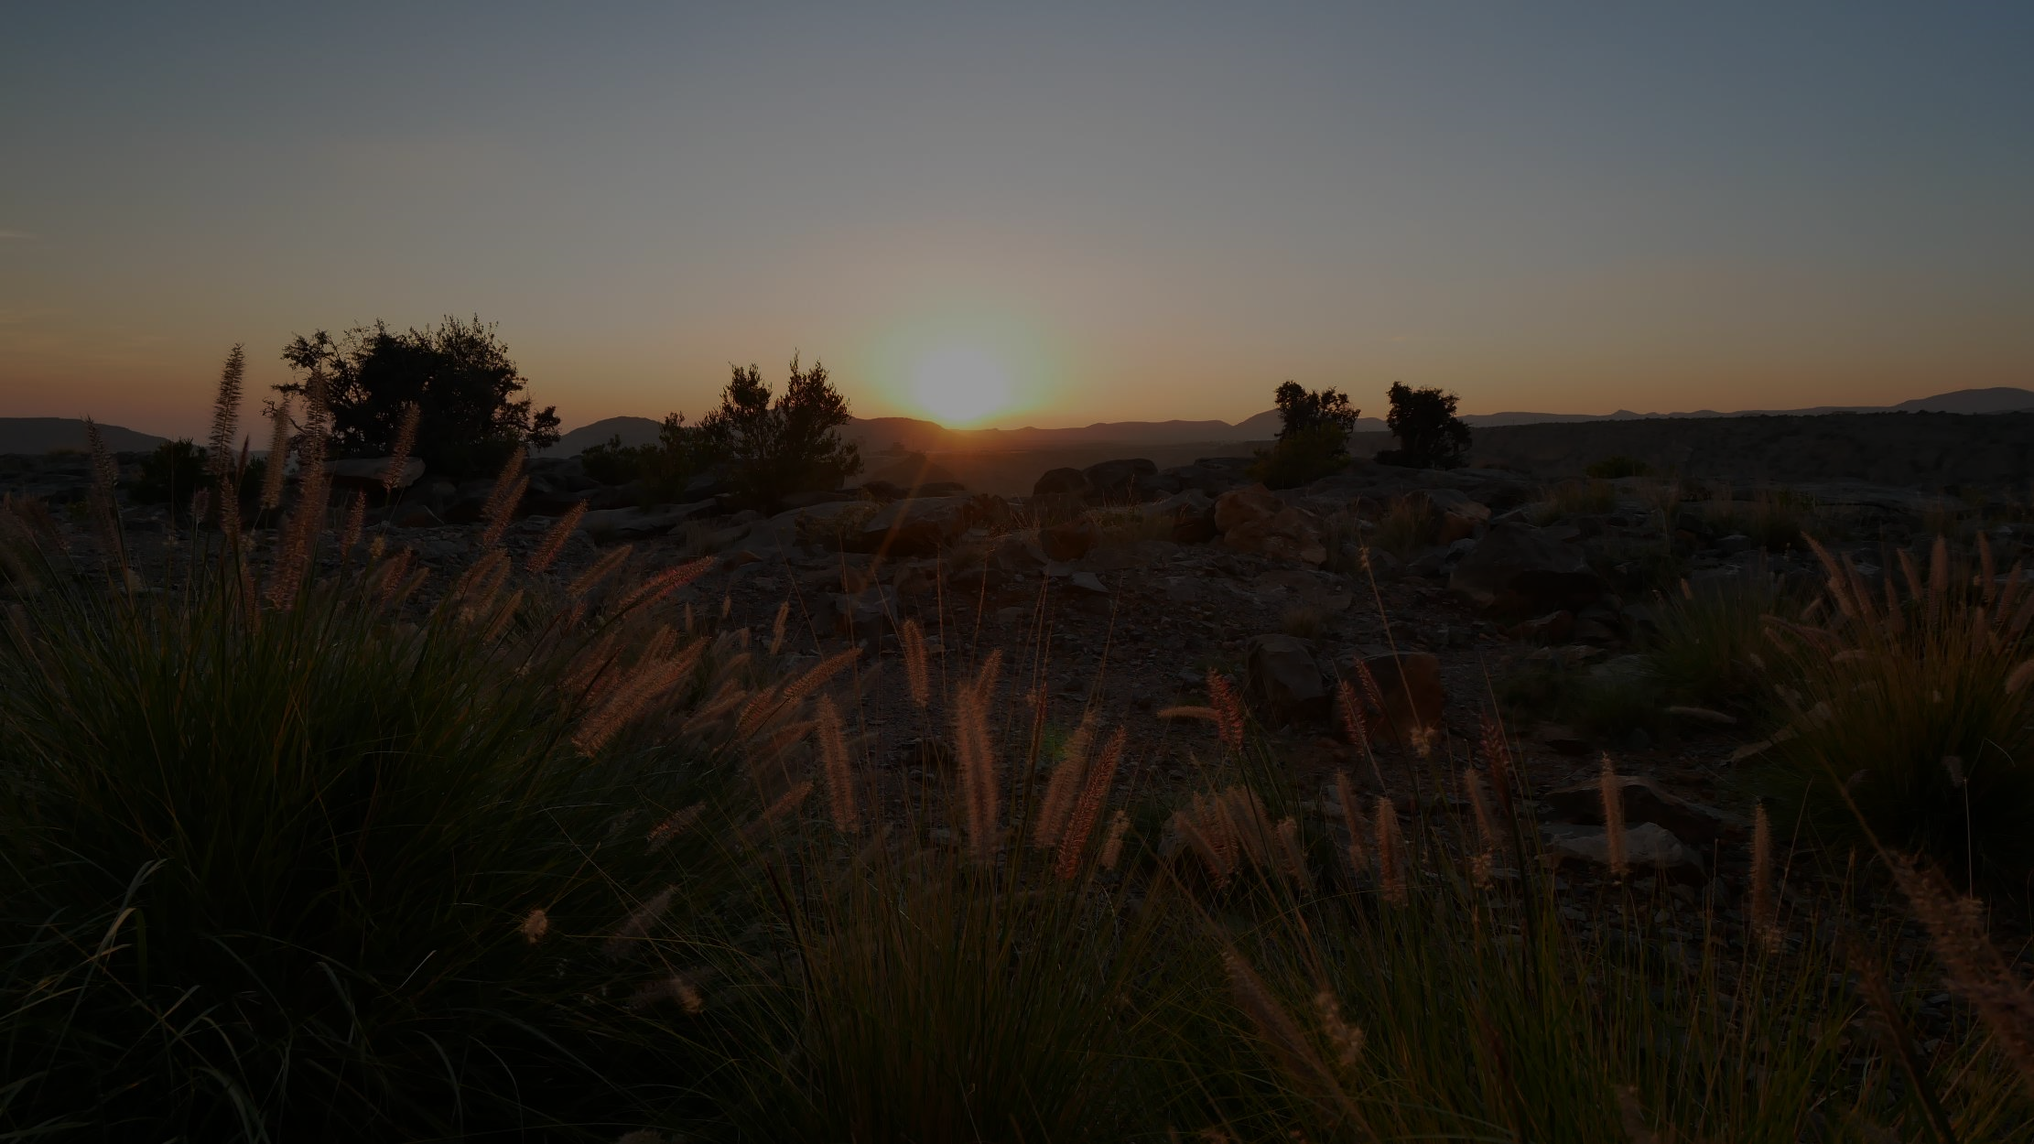
Many thanks for
your attention.
You have questions, want to exchange or get involved? Gladly anytime!
Digitize the Planet e. V.
Kreuzbergstraße 30
10965 Berlin
Sebastian Sarx
Tel. +49 30 32793119
mail@digitizetheplanet.org

